Slide 1


Robert L Maglies
5/11/2023

Slide 2

Table of Contents
Executive Summary
Introduction
Methodology
Results
Conclusion
Appendix

Slide 3
Executive Summary
This project was performed to help Space X determine whether the first stage of their Falcon 9 Rocket Launches will land successfully. This has strong ramifications on cost of launch due to savings from reuse of first stage. analyze Space X Falcon 9 Launch Data and determine what Machine Learning Models
Methodologies Summary:
Data Collection through API’s and Web Scraping
Data Wrangling to transform data
Exploratory Data Analysis with SQL. And Visuals.
Folium used to create Interactive map and explore proximities.
Dashboard created with Plotly Dash to create interactivity with data.
Test Predictive Models to determine best fit for gauging successful landings
Results Summary:
Results will come in various forms:
Exploratory Data Analysis Results (Queries, Charts, Maps, and Interactive Dashboards)
Predictive Model Analysis Results

Slide 4
Introduction
Project background and context
SpaceX advertises Falcon 9 rocket launches on its website, with a cost of 62 million dollars; other providers cost upward of 165 million dollars each, much of the savings is because SpaceX can reuse the first stage. Therefore, if we can determine if the first stage will land, we can determine the cost of a launch. This information can be used if an alternate company wants to bid against SpaceX for a rocket launch.
Problems you want to find answers
Will the Falcon 9 Rocket’s first stage land successfully?
What is the cost of a launch?
How much correlation between variables (launch site, payload mass, booster version, etc) and landing success rate?
What classification model will best predict launch success?
Notes:
Project background and context
Problems you want to find answers

Slide 5

Section 1

Slide 6
Methodology
Executive Summary
Data collection methodology:
API – Using SpaceX API with helper functions to pull in Falcon 9 Launch information
Webscraping – Used Beautiful Soup to web scrape Falcon 9 and Heavy Launch from Wikipedia.
Perform data wrangling
Add in variable “Class”, using a value of ”1” for Successful Landing and ”0” for Unsuccessful
Perform exploratory data analysis (EDA) using visualization and SQL
Perform interactive visual analytics using Folium and Plotly Dash
Perform predictive analysis using classification models
Build, tune, & evaluate classification models (Logistic Regression, Decision Trees, K Nearest Neighbors, & Support Vector Machines)

Slide 7
Data Collection
Needed to collect data before EDA can be performed. Used below methods to create & fill our dataframe.
API Call – SpaceX Database
Web Scraping – HTML Table from Wikipedia page on SpaceX Rocket Launches
Data Collection
Data Wrangling
Exploratory Data Analysis
Predictive Modeling
API
Web Scraping
Notes:
Data Sets were collected using both API calls to SpaceX and Webscraping an HTML table from Wikipedia.
API Call
Web Scraping
You need to present your data collection process use key phrases and flowcharts

Slide 8
Data Collection – SpaceX API
Data Collection was completed by using an API request on SpaceX database.
Did this by:
Requesting and Parsed SpaceX launch data using the GET request
Requested Space X data from API Get Request
Downloaded JSON file from Course Database (Ensured consistency)
Decoding Response content as a Json using .json()
Turning into Pandas DF using .json_normalize()
Checked the head and discovered a lot of data is ID’s.
Using API again to get info about launches using ID’s given for each launch.
Took a subset of dataframe keeping features we want, flight number, and date_utc
Removed rows with multiple cores to avoid misinformation
Since payloads and cores are lists of size 1, extract the single value in the list and replace the feature
Converted the date_utc to a datetime datatype and then extracted the date leaving the time
Using the date, restricted the dates of the launches
Creating blank Global Variable lists & use GET helper functions to append the data into lists
Created Global Variables as blank lists for each variable for data to fill into
Applied GET Helper functions to fill lists/columns with data for each variable needed
Constructed dataset by combining columns into a dictionary
Created Pandas dataframe from dictionary
Filtering dataframe to only include Falcon 9 launches
Filtered dataframe based on booster version to keep only Falcon 9 launches
Saved the filtered data to a new dataframe called “data_falcon9”
Reset the Flight number since we removed columns
Github URL:
Used the API GET request for SpaceX launch data.
Turn into Pandas DF using .json_normalize()
Use API again to get info about launches using ID’s given for each launch.
Combined lists/columns into a dictionary and create Pandas dataframe from dictionary
Filtered dataframe to only include Falcon 9 launches based on booster version.
Reset the Flight number since we removed columns and exported to CSV
Decoded Response content as a Json using .json()
Create blank Global Variable Lists and use GET helper functions to append the data into lists
Notes:
Present your data collection with SpaceX REST calls using key phrases and flowcharts
Add the GitHub URL of the completed SpaceX API calls notebook (must include completed code cell and outcome cell), as an external reference and peer-review purpose

Slide 9
Data Collection - Scraping
Data Collection by Web Scraping was done on Falcon 9 historical launch records within an HTML Table on Wikipedia titled “List of Falcon 9 and Falcon Heavy Launches” using Beautiful Soup to extract.
Did this by:
Requesting Falcon 9 Launch Wiki page from it’s URL.
HTTP Get Method to request HTML page as HTML response
Createing Beautiful Soup object from the HTML response
Print Page to ensure beautifulsoup object created properly.
Extracting All column/variable Names from the HTML Table header
Find All tables on Wiki - use find_all function with element type ‘table’
Print the third table, which is one desired, and
inspect table headers <th> and see column names embedded.
Use loop to iterate through <th> elements, applying the extract_column_from_header() function provided.
Print extracted column names.
Creating a Data frame by parsing the launch HTML tables
Create empty dictionary with keys from the extracted column names in previous task to use for pd dataframe later.
Loop through the table row data from the wiki page, appending the table row data to the dictionary for each header extracted using the helper functions provided.
Check for inconsistencies in counts to ensure ease of creating pandas df.
Create pandas df from the launch_dict
Github URL:
HTTP Get Method to request Falcon 9 Launch Wiki page from it’s URL.
Extracted All column/variable Names from the HTML Table header
Create a Pandas dataframe from Dictionary
Create Beautiful Soup Object from HTML Response
Create Empty Dictionary with Column Names & Add Table Row data to Dictionary using helper functions.
Notes:
Present your web scraping process using key phrases and flowcharts
Add the GitHub URL of the completed web scraping notebook, as an external reference and peer-review purpose

Slide 10
Data Wrangling
Data was processed to create a create a variable “Class” which shows failed or successful Outcome. Allows for Success Rate to be determined.
Did this by:
Calculating the number of launches on each site
Used the method value_counts() on the column LaunchSite to determine the number of launches on each site
Calculating the number and occurrence of each orbit
Used the method .value_counts() to determine the number and occurrence of each orbit in the column Orbit
Calculating the number and occurrence of mission outcome per orbit type
Used the method .value_counts() on the column Outcome to determine the number of landing_outcomes. Then assign it to a variable landing_outcomes.
Created a set of unsuccessful outcomes called bad_outcomes
Creating a landing outcome label from Outcome column
Using the Outcome, created a list where the element is zero if the corresponding row in Outcome is in the set bad outcome; otherwise, it's one. Then assigned it to the variable landing_class.
Used variable to create classification variable ‘Class’, representing the outcome of each launch. 0 is a failed landing, 1 is a successful landing.
From this you used .mean() to see the success rate.
Github URL:
Calculating the number of launches on each site
Calculating the number and occurrence of each orbit
Calculating the number and occurrence of mission outcome per orbit type
Creating a landing outcome label from Outcome column of each orbit
Notes:
Describe how data were processed
You need to present your data wrangling process using key phrases and flowcharts
Add the GitHub URL of your completed data wrangling related notebooks, as an external reference and peer-review purpose

Slide 11
EDA with Data Visualization
Tests were done to explore the data and understand how each variable affects the success rate.
Scatter Point Chart (Catplot) - Best for understanding variability between data points
Flight Number and Launch Sites
Payload and Launch Site
Flight Number and Orbit type
Payload and Orbit type
Bar Chart – Best for visualizing summarized data values
Success Rate of Each Orbit Type
Line Chart – Best for visualizing trends over time
Visualized the Launch Success yearly trend
Github Link:
Notes:
Summarize what charts were plotted and why you used those charts
Add the GitHub URL of your completed EDA with data visualization notebook, as an external reference and peer-review purpose

Slide 12
EDA with SQL
Exploratory Data Analysis was done using SQL to gain a better understanding of the dataset.
SQL Queries and Operations Performed:
Displayed Unique launch sites in the space mission
Displayed 5 records where launch sites begin with the string ‘CCA’
Displayed total payload mass carried by boosters launched by NASA (CRS)
Displayed average payload mass carried by booster version F9 v1.1
Listed the date when the first successful landing outcome in ground pad was achieved.
Listed names of boosters which have success in drone ship and have payload mass greater than 4000 but less than 6000
Listed total number of successful and failure mission outcomes
Listed the names of the booster_versions which have carried the maximum payload mass. Used a subquery.
Listed the records which will display the month names, failure landing_outcomes in drone ship, vbooster versions, and launch_site for the months in the year 2015.
Ranked the count of successful landing_outcomes between the date 04-06-2010 and 20-03-2017 in descending order
Github URL:
Notes:
Using bullet point format, summarize the SQL queries you performed
Add github link

Slide 13
Build an Interactive Map with Folium
How & What was put onto a Map?
Marked all Launch Sites on a map.
Added a folium.Circle and folium.Marker on a site map for each Launch Site to get general understanding of their locations. Also helps to answer questions like are launch sites close to equator line, or close to the coast?
Marked the success/failed launches for each site on the map.
Created a Marker Cluster with Green and Red Markers indicating successful or unsuccessful launches.
Calculated the distances between a launch site to its proximities
Made a PolyLine to the coastline point.
Made Markers of the distance to main road and coastline.
Made Markers and PolyLine to Orlando, nearest major city.
Why did we use Interaction Mapping?
Helps us understand the relationships of launch sites and their proximity to highways, railways, coastlines, and cities.
Helps us understand the relationship between proximities & success rates,
Can help discover ideal launch site locations.
GitHub URL:

Slide 14
Build a Dashboard with Plotly Dash
Plots, Graphs, & Interactions Used
Dropdown
Selects Booster Version(s)
Pie Chart
Displays Success Rate vs. Booster Version(s)
Payload Slider
Displays Payload Mass range
Scatter Plot
Displays Payload Mass vs Success Rate
Questions Answered by Dashboard:
Which site has the most successful launches?
KSC LC-39A with 10
Which site has the highest launch success rate?
KSC LC-39A with 76.9%
Which payload range(s) has the highest launch success rate?
4,000 – 6,000 Payload Rannge
Which payload range(s) has the lowest launch success rate?
6,000 – 9,000 Payload Range
Which F9 Booster version (v1.0, v1.1, FT, B4, B5, etc.) has the highest launch success rate?
FT
Github URL:

Slide 15
Predictive Analysis (Classification)
Summarize how you built, evaluated, improved, and found the best performing classification model
Load in Space X Dataset & Create Numpy array from the column Class in data.
Standardize the data in X then reassign it to the variable X using the transform
Split the data into training and testing data using the function train_test_split. Training data is divided into validation data, a second set used for training data; then the models are trained and hyperparameters are selected using the function GridSearchCV.
We output the GridSearchCV object for logistic regression. We display the best parameters using the data attribute best_params and the accuracy on the validation data using the data attribute best_score.
Calculate accuracy of on test data using the method score and looked at Confusion Matrix
Examining Confusion Matrix, see that Logistic Regression can distinguish between the different classes. We see the major problem is false positives.
Cycle through all Classification Models, checking accuracy and conf matrix.
Logistic Regression
Decision Tree Classifier
Support Vector Machine
K Nearest Neighbors
Created Bar Chart for visual representation of accuracy.
Create NumPy array from the column Class in data.
Standardize the data
Split the data into training and testing data using the function train_test_split.
We output the GridSearchCV object for logistic regression. We display the best parameters using the data attribute best_params and the accuracy on the validation data using the data attribute best_score.
Calculate accuracy of on test data using the method score and looked at Confusion Matrix
Examing Confusion Matrix, see that logistic. Regression an distinguish between the different classes. We see the major problem is false positives.
Cycle through all Classification Models, checking accuracy and conf matrix.
Logistic Regression
Decision Tree Classifier
Support Vector Machine
K Nearest Neighbors
Created Bar Chart for visual representation of accuracy.
Then the models are trained and hyperparameters are selected using the function GridSearchCV.
Github URL:
Notes:
Summarize how you built, evaluated, improved, and found the best performing classification model
You need present your model development process using key phrases and flowchart
Add the GitHub URL of your completed predictive analysis lab, as an external reference and peer-review purpose

Slide 16
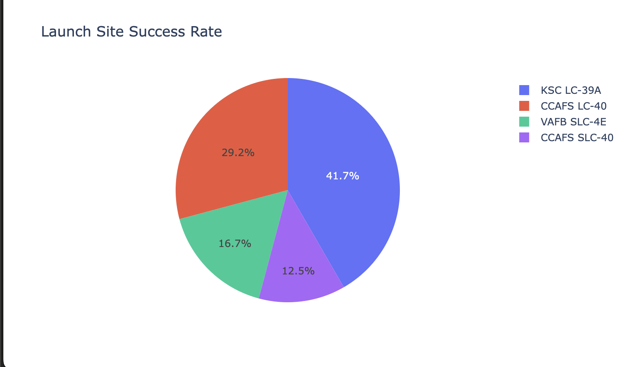
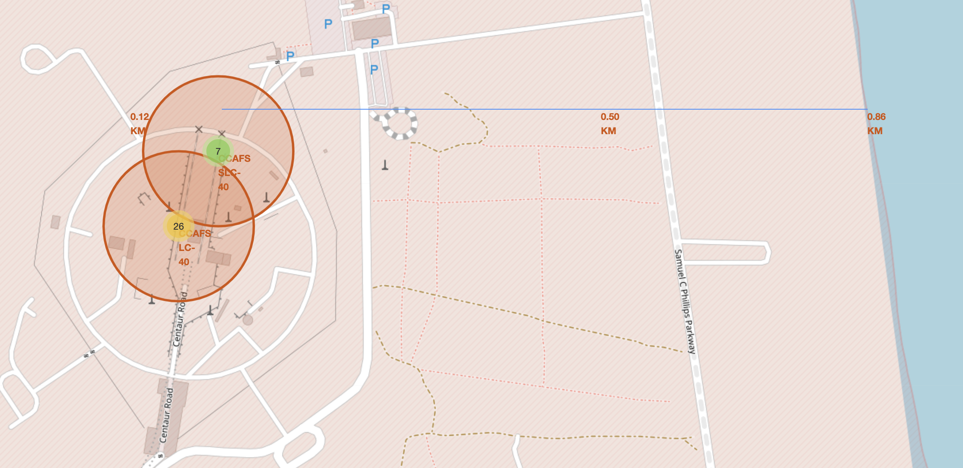
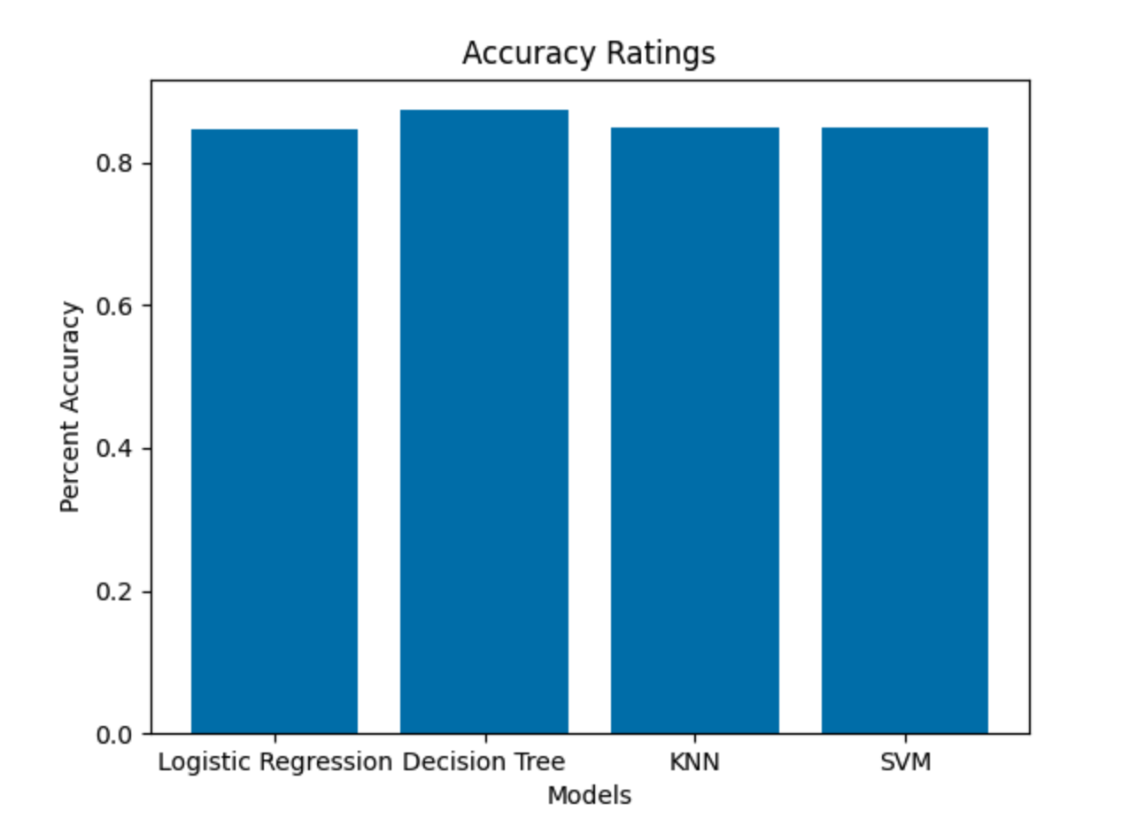
Results
Exploratory data analysis results
ES-L1, GEO, HEO, and SSO Orbits have the highest success rate of 100%.
Higher the flight number the better the success rate becomes
VAFB has no rockets launched above 10k and KSC none below 2k
Only Booster Version B5 has carried Max Payload
Interactive analytics demo in screenshots
Dashboard w/ Plotly Dash showing Success Rates compared across Launch Sites.
Folium Map showing close proximities to Coastline, Highways, and Train Tracks
Predictive analysis results
Decision Tree proved best Classification Algorithm at 87.3% Success Rate.
Notes:
Exploratoy data analys results
Interactice demo in screenshots
Predictive Analysis Results

Slide 17

Section 2

Slide 18
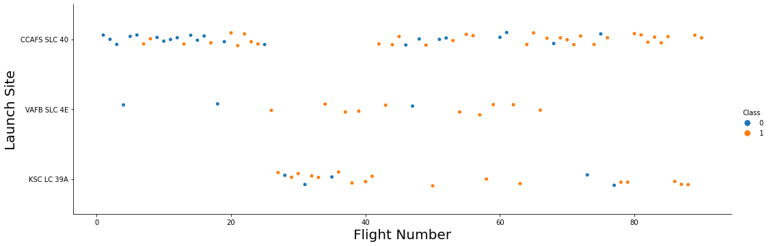
Flight Number vs. Launch Site
Higher the flight number the better the success rate becomes
CCAFS has most launches & first ~25-30 launches. Explains low success rate rate at 60%.
Notes:
Show a scatter plot of Flight Number vs. Launch Site
Show the screenshot of the scatter plot with explanations

Slide 19
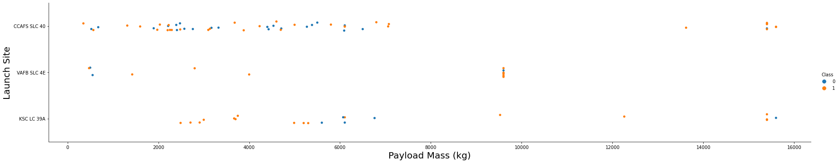
Payload vs. Launch Site
Discovered VAFB launch site has no rockets launch for a payload mass greater than 10k.
KSC Launch Site has no rockets launched below 2k payload mass.
Notes:
Show a scatter plot of Payload vs. Launch Site
Show the screenshot of the scatter plot with explanations

Slide 20
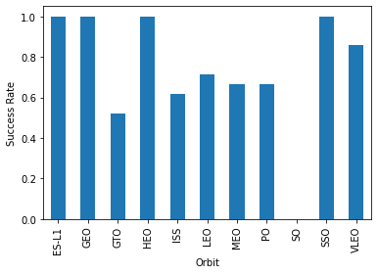
Success Rate vs. Orbit Type
Showed that ES-L1, GEO, HEO, and SSO have the highest success rate of 100%.
GTO Orbit has the lowest Success Rate.
Notes:
Show a bar chart for the success rate of each orbit type
Show the screenshot of the scatter plot with explanations

Slide 21
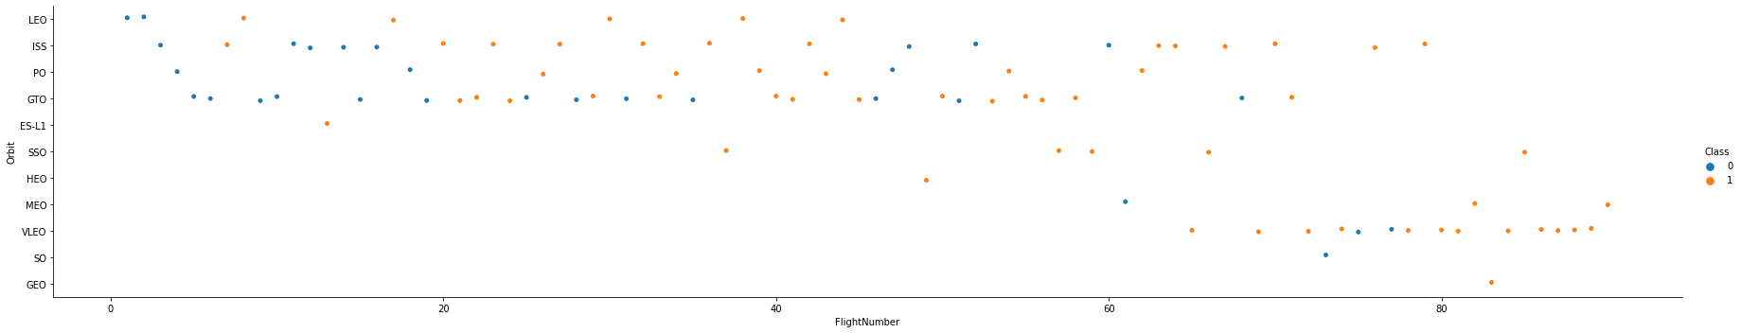
Flight Number vs. Orbit Type
The success rate for LEO’s orbit seems to be related to Flight Number
No relationship between flight number when in GTO Orbit
Notes:
Show a scatter point of Flight number vs. Orbit type
Show the screenshot of the scatter plot with explanations

Slide 22
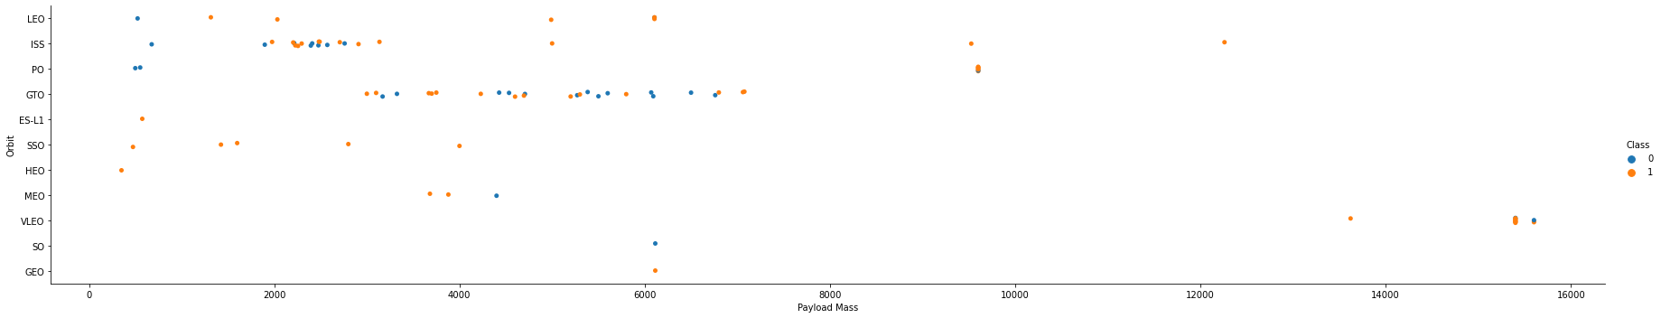
Payload vs. Orbit Type
Polar, LEO, and ISS seem to have more successful landings with heavy payloads.
Unable to distinguish for GTO due to occurrence of both successful and unsuccessful landings as payload increased.
Notes:
Show a scatter point of payload vs. orbit type
Show the screenshot of the scatter plot with explanations

Slide 23
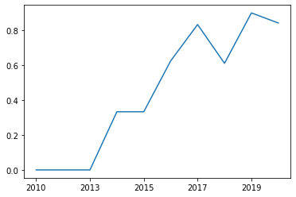
Launch Success Yearly Trend
Success rate has continued to increase through 2020.
2018 had a large dip, trending back upward in 2019.
Notes:
Show a line chart of yearly average success rate
Show the screenshot of the scatter plot with explanations

Slide 24
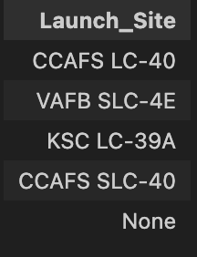
All Launch Site Names
This allows us to know how many sites we are working with and the accurate names of each.
Notes:
Find the names of the unique launch sites
Present your query result with a short explanation here

Slide 25
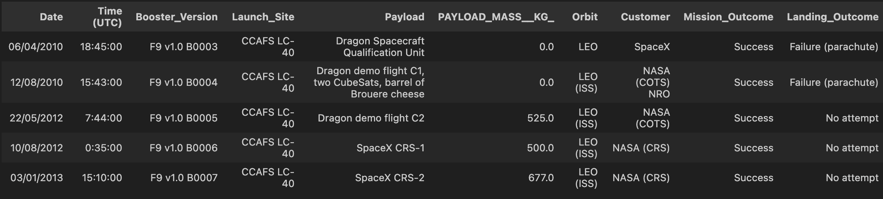
Launch Site Names Begin with 'CCA'
Helped gain understanding of mix of variables tied to launch sites starting with “CCA”
Some launches had no Payload Mass.
There is a difference between Mission_Outcome & Landing_Outcome.
Notes:
Find 5 records where launch sites begin with `CCA`
Present your query result with a short explanation here

Slide 26
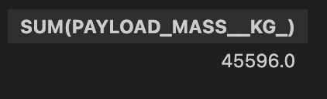
Total Payload Mass Carried by Boosters from NASA
This can be used to see how much of the total payload mass carried was from boosters by NASA
Notes:
Calculate the total payload carried by boosters from NASA
Present your query result with a short explanation here

Slide 27
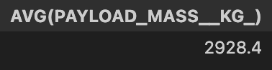
Average Payload Mass by F9 v1.1
This shows us the average Payload carried by a singular booster version.

Slide 28

First Successful Ground Landing Date
Shows us that it wasn’t until 2018 that they successfully landed on a ground landing pad.
Adds clarity to timeline of water vs ground landing outcomes.

Slide 29
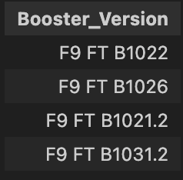
Successful Drone Ship Landing with Payload between 4000 and 6000
Lists the names of boosters which have successfully landed on drone ship and had payload mass greater than 4000 but less than 6000
Can be used to gauge performance as payloads increase or decrease.

Slide 30
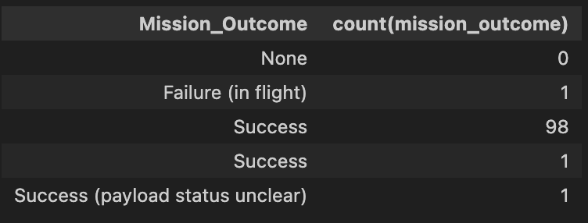
Total Number of Successful and Failure Mission Outcomes
Shows us that nearly all missions had successful outcomes.
Can be used to compare against Landing_Outcome.

Slide 31
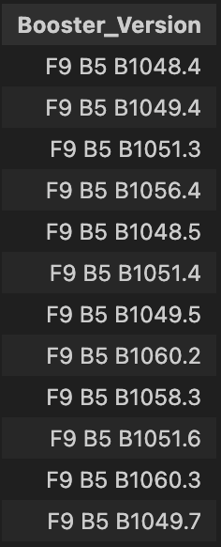
Boosters Carried Maximum Payload
Shows a large number of boosters have carried Maximum Payload.
Shows trend of F9 B5 Booster Versions having best success at Max Payload.

Slide 32
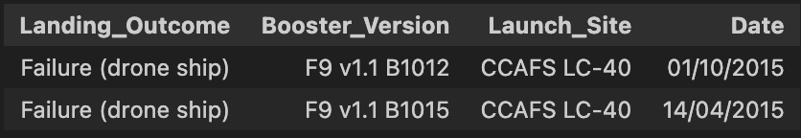
2015 Launch Records
Lists the failed landing_outcomes in drone ship, their booster versions, and launch site names for year 2015.
Shows trend of F9. V1.1 booster having poor performance on drone ship landings.

Slide 33
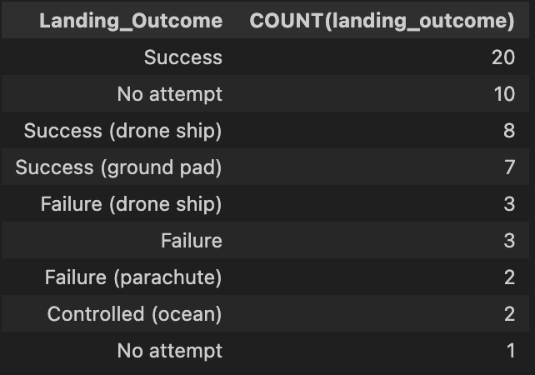
Ranked Landing Outcomes Between 2010-06-04 and 2017-03-20
Successful Landing_Outcomes are more common through this timeframe than failures.
Many successes not attributed to a ground pad or drone ship.

Slide 34

Section 3

Slide 35
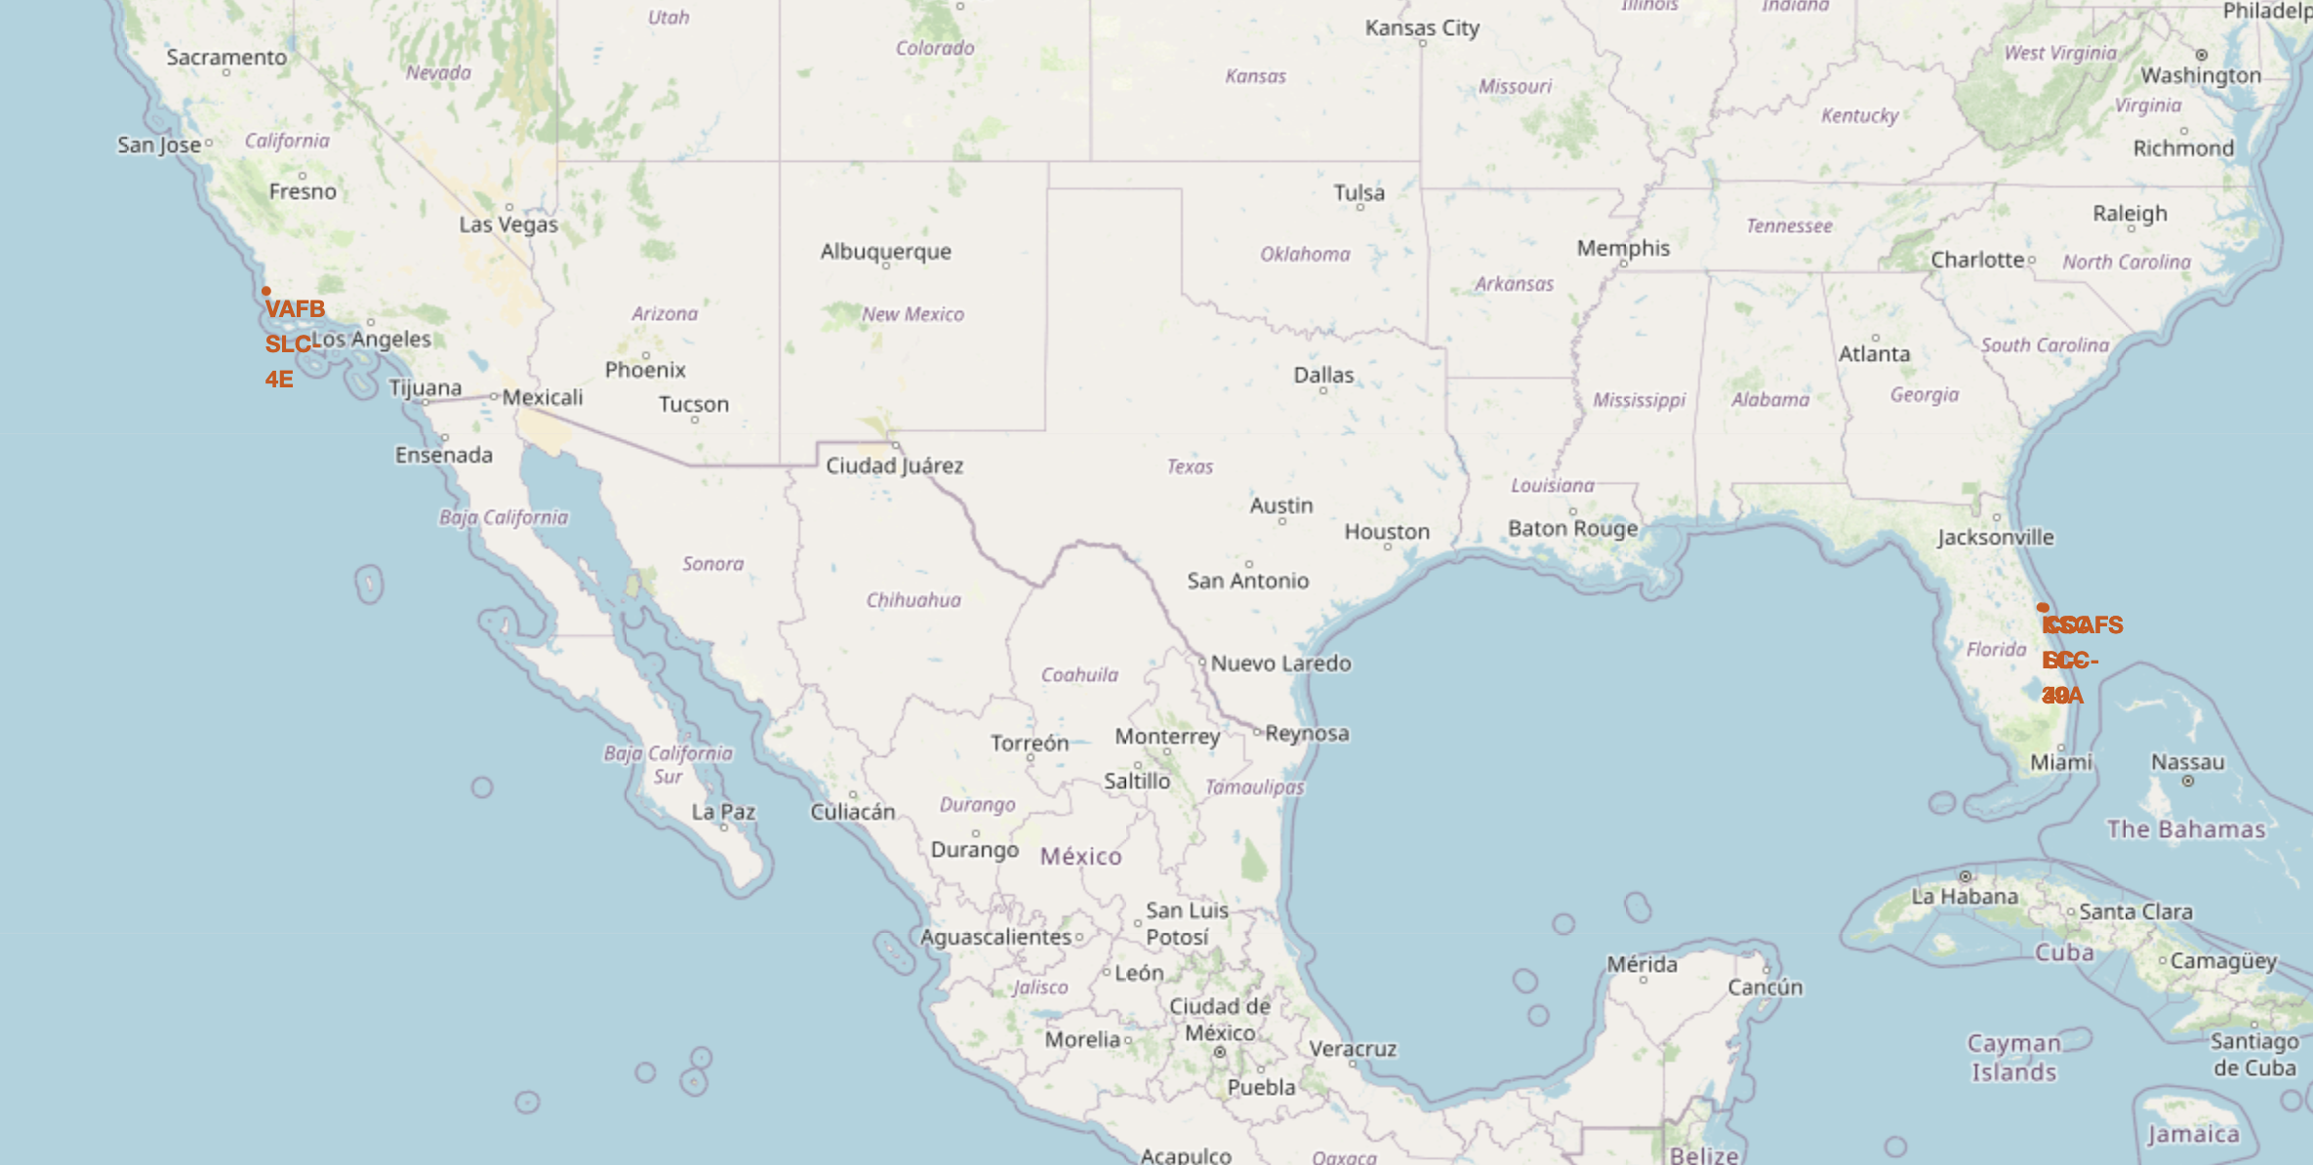
Launch Site Markers on a Global Map
Always near coastlines.
Split between East and West Coast
All near equator line

Slide 36
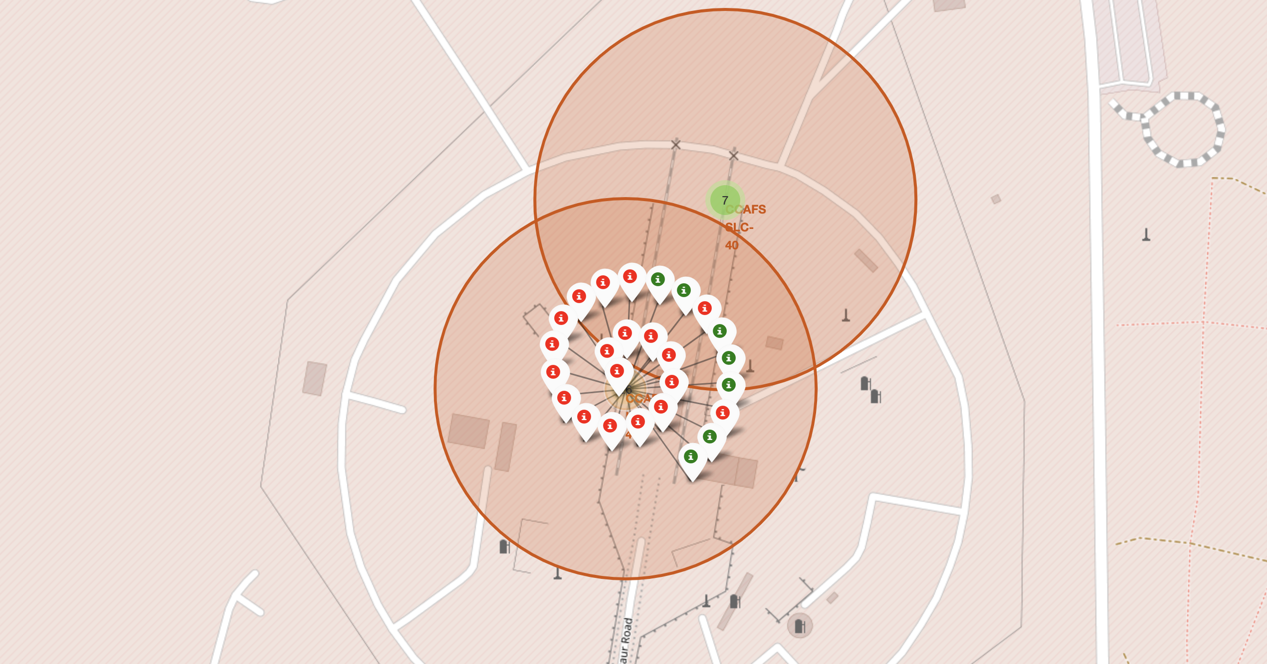
CCAFS Launch
CCAFS launch sites and successful/unsuccessful launches shown visually.
Shows proximity of CCAFS sites to each other.
Notes:
Replace <Folium map screenshot 2> title with an appropriate title
Explore the folium map and make a proper screenshot to show the color-labeled launch outcomes on the map
Explain the important elements and findings on the screenshot

Slide 37
CCAFS Launch Sites Distance to Proximities
CCAFS Launch Sites just under 1 kilometer to coastline and just over ½ kilometer to parkway.
Launch Sites trend near Highways, Coastlines, and train tracks and trend away from Cities.

Slide 38

Section 4

Slide 39
Launch Site Success Rate
KSC LC-39A shows the highest launch success rate.
CCAFS SLC-40 has the lowest success rate.
Notes:
Replace <Dashboard screenshot 1> title with an appropriate title
Show the screenshot of launch success count for all sites, in a piechart
Explain the important elements and findings on the screenshot

Slide 40
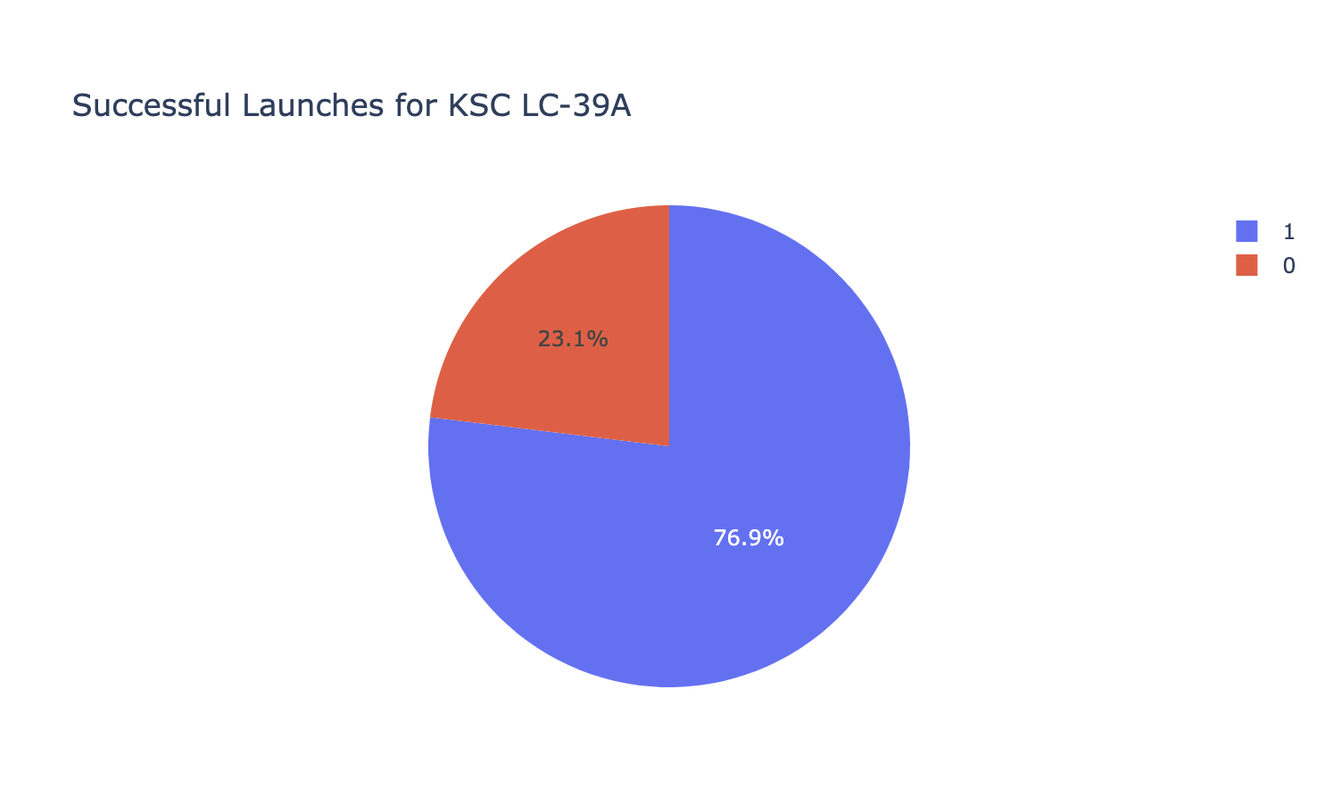
Top Performing Launch Site Success Ratio
KSC LC-39A is most successful launch site
Launch success rate for top performing site is 77%.
Notes:
Replace <Dashboard screenshot 2> title with an appropriate title
Show the screenshot of the piechart for the launch site with highest launch success ratio
Explain the important elements and findings on the screenshot

Slide 41
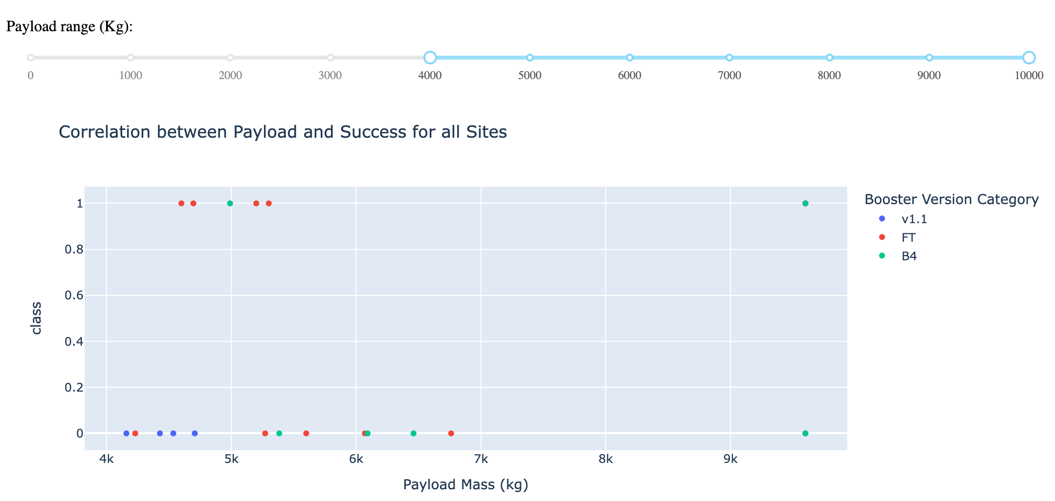
Payload vs. Launch Outcome beyond 4k Payload
Best Success came between 4-6k with FT and B4 Booster Version Categories.
No success with Payload Range between 6-9k.
Booster Version Category B4 has only successful launch above 5.5k.
Notes:
Replace <Dashboard screenshot 3> title with an appropriate title
Show screenshots of Payload vs. Launch Outcome scatter plot for all sites, with different payload selected in the range slider
Explain the important elements and findings on the screenshot, such as which payload range or booster version have the largest success rate, etc.

Slide 42

Section 5

Slide 43
Classification Accuracy
Best Performing Model:
Decision Tree Classification
Decision Tree: 87.3%
K Nearest Neighbors: 84.8%
Support Vector Machine: 84.8%
Logistic Regression: 84.6%
Notes:
Visualize the built model accuracy for all built classification models, in a bar chart
Find which model has the highest classification accuracy

Slide 44
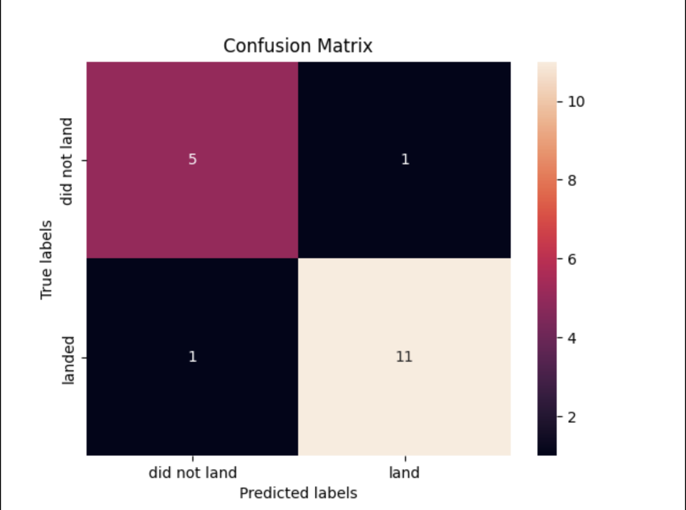
Confusion Matrix
Best Performing Model:
Decision Tree Classification
This model limited the false positive predictions the most.
Notes:
Show the confusion matrix of the best performing model with an explanation

Slide 45
Conclusions
To conclude, we revisit the questions we initially sought answers for.
Will the Falcon 9 Rocket’s first stage land successfully?
Decision Tree Predictive Model can predict a 87.3% landing success rate.
What is the cost of a launch?
Still needs more analysis to determine.
Could use best accuracy rating from classification model to create pricing model to cover for losses if first stage unable to land.
How much correlation between variables (launch site, payload mass, booster version, etc) and landing success rate?
Launch Site – KSC seems to perform best and has highest Success Rate.
Payload Mass & Booster Version – Booster Version must depend on Payload Mass and likewise.
Orbit Type – Success in Orbit type seems to be tied to Flight Number most, increasingly successful as more flights donne.
What classification model will best predict launch success?
Decision Tree Model predicts Launch Success best with an. 87.3% accuracy rating.

Slide 46
Appendix
THANK YOU
Coursera & IBM

Slide 47


